Slide 1
Data & Outputs

Slide 2
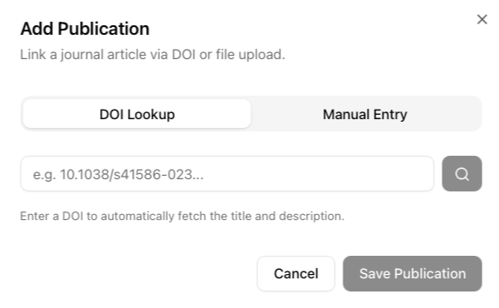
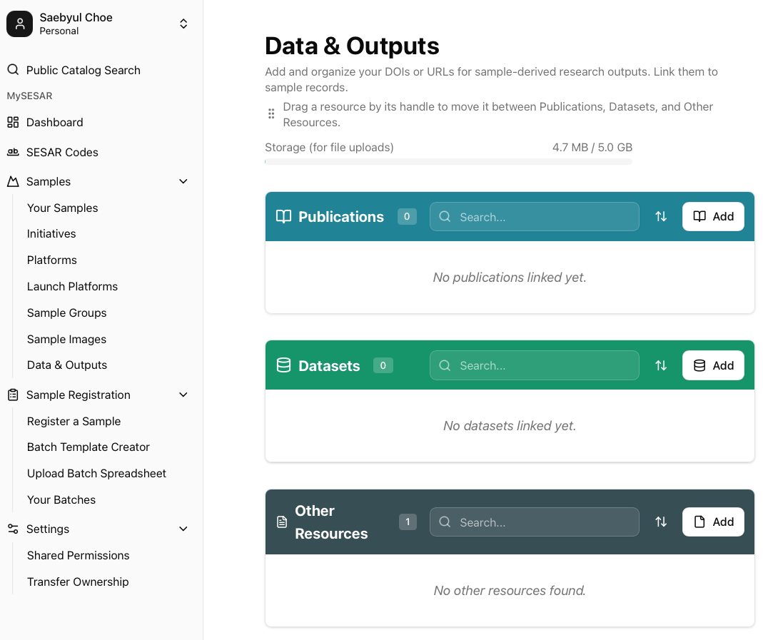
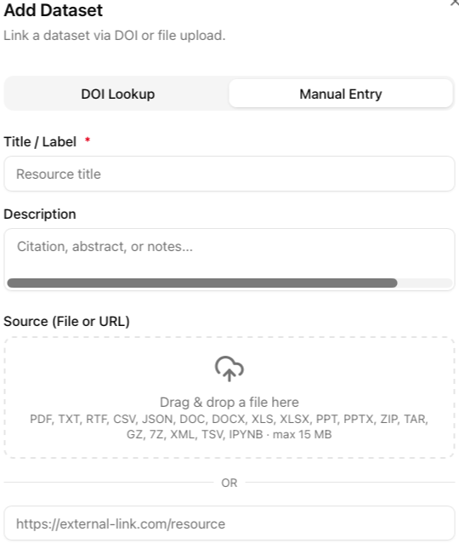
Data & Outputs
Data & Outputs in Samples is the designated location where your related publications, datasets, and other resources are stored.
Steps for adding publication, dataset, and other resources is the same.
Click Add to input a new publication, dataset, or other resource.
Input the DOI in DOI Lookup to search and add your resource.
Enter the resource information along with a file or external link in Manual Entry.
The maximum size for file uploads is 15MB.

Slide 3
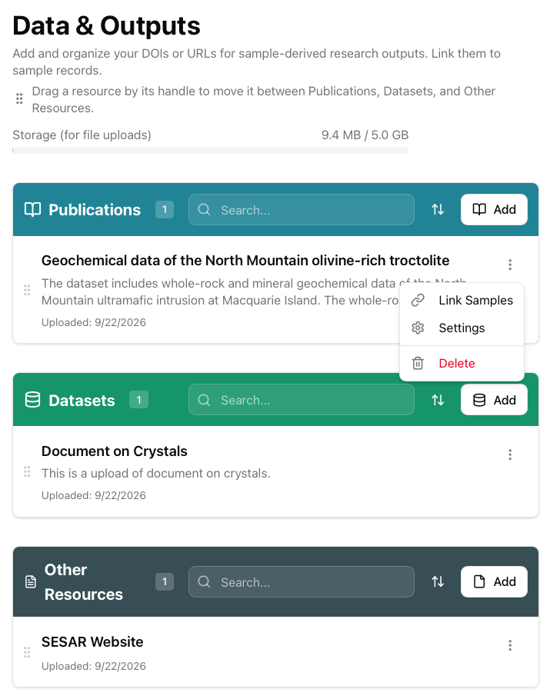
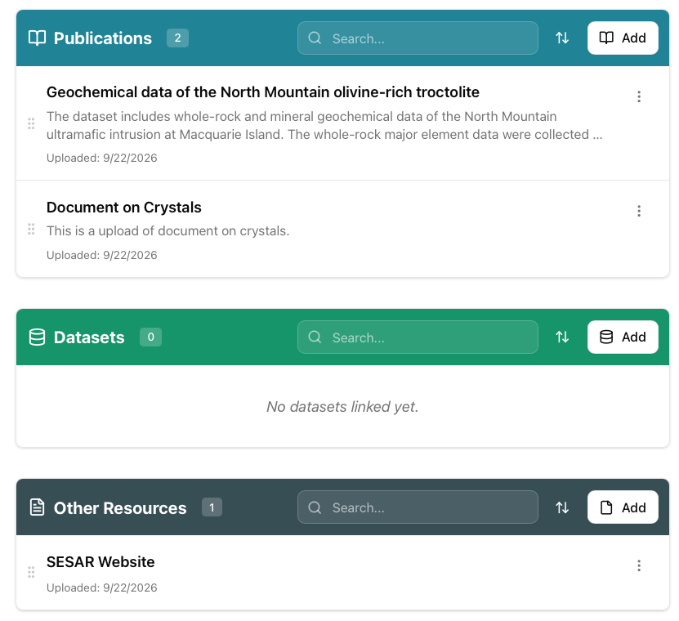
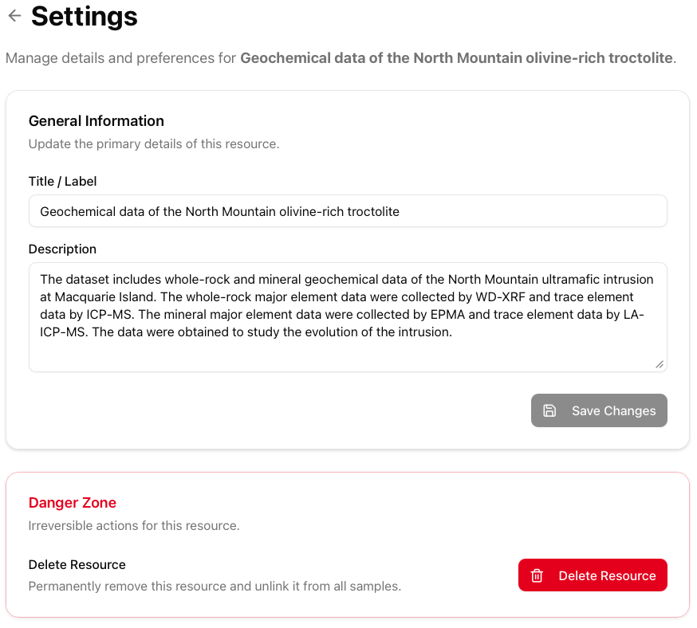
Data & Outputs
Using the three dots on the right corner, Link Samples, edit resource under Settings, and Delete your resource.
Delete Resource is also found under Settings.
Use the left six buttons to drag and drop resources between Publications, Datasets, and Other Resources.
Like Images, the Data & Outputs has a 5GB limit.

Slide 4
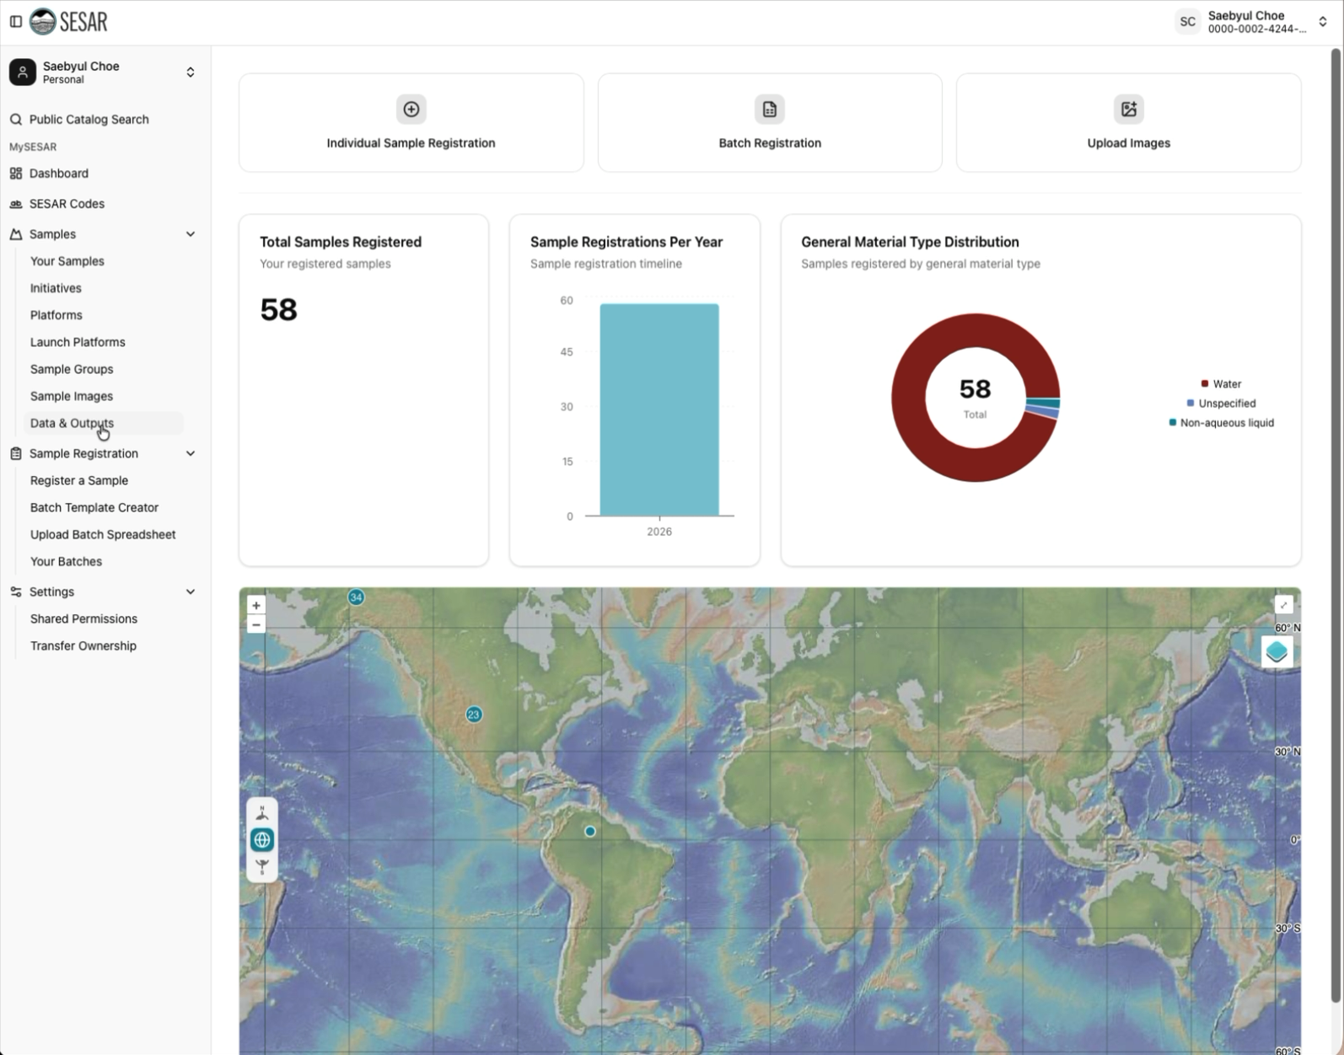
VIDEO Tutorial

